Slide 1
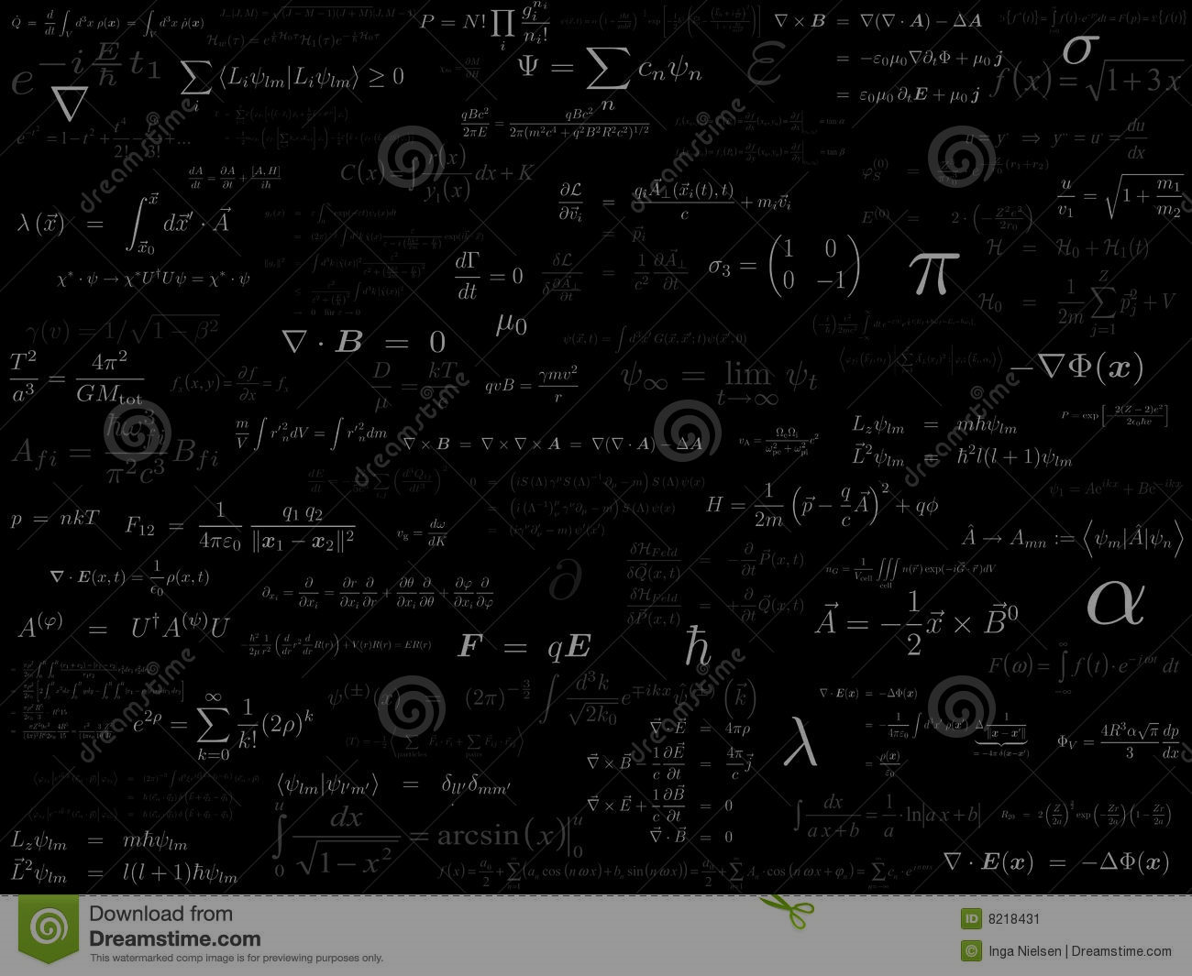
Methods in quantum computing
Quantum hardware implementations

Slide 2
Basic hardware ingredients
Fortschritte der Physik,
48 771-783 (2000)
A scalable physical system with well characterised qubits
The ability to initialise the qubits
Long decoherence times, much longer than gate operation times
A universal set of quantum gates
A qubit-specific measurement capability

Slide 3
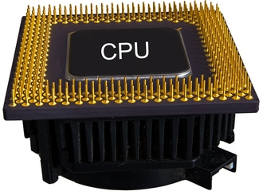
From bits to qubits
1
Classic bits: 1 or 0
What is the quantum analogue?
0

Slide 4





From bits to qubits
A qubit is a 2D system:
Quantum bits:
$$\left|0\right\rangle =\left(\begin{matrix}1 \\ 0\end{matrix}\right)$$
$$\left|1\right\rangle =\left(\begin{matrix}0 \\ 1\end{matrix}\right)$$
$$|1⟩$$
$$\left|ψ\right\rangle =c_{0}|0〉+c_{1}|1〉$$
Bloch’s sphere
$$|0⟩$$
More generally: $\left|ψ\right\rangle =c_{0}|0〉+c_{1}e^{iθ}|1〉$

Slide 5

Qubit operations in the lab
Quantum gates map an input state onto an output state through a Unitary:
$$|ψ_{out}〉=U|ψ_{in}〉$$
Experimental quantum systems follow the Schroedinger equation:
$$iℏ\frac{d}{dt}|ψ〉=𝓗|ψ〉→U\left(t\right)=e^{−\frac{i}{ℏ}𝓗t}$$
The goal is to implement a $𝓗$ such that $U\left(τ\right)=U_{target}$

Slide 6





Qubit operations in the lab
Pauli matrices:
Qubit Hamiltonian:
$$σ_{x}=\left(\begin{matrix}0 & 1 \\ 1 & 0\end{matrix}\right)$$
$$𝓗=ℏ\left(Δσ_{z}+Ω_{x}σ_{x}+{Ω_{y}σ}_{y}\right)$$
$$σ_{y}=\left(\begin{matrix}0 & \text{-}i \\ i & 0\end{matrix}\right)$$
$$|1⟩$$
$$=ℏ\left(\begin{matrix}Δ & Ω_{x}−iΩ_{y} \\ Ω_{x}+iΩ_{y} & \text{-}Δ\end{matrix}\right)$$
$$σ_{z}=\left(\begin{matrix}1 & 0 \\ 0 & \text{-}1\end{matrix}\right)$$
$$|0⟩$$
Notes:
Pauli matrices are very relevant to qubit systems for two main reasons:
1 – Each matrix is an observable, that when applied as a measurement to a state, projects the state into the x, y or z axes
2 – The Pauli matrices, with the addition of the identity, form a basis of the space of 2D Hermitian matrices. This means that you can construct any 2D Hamiltonian using a linear combination of these matrices, using real coefficients.
To make a qubit, we need to engineer a system that follows this qubit Hamiltonian. When you evolve a state under this Hamiltonian, what you get is that $Δ$ will cause the state to rotate around the z-axis, with the amplitude of $Δ$ determining the speed of the rotation (the $ℏ$ in the Hamiltonian implies that the parameters have units of frequency), and its sign determining the direction of rotation. Similarly the $Ω$s will cause the spin to rotate around the x and y axis. So if we have a system that allows us to control all three of these parameters, then if we know the initial state of the system, we can apply these rotations in a controlled way to transform the state to any other possible state on the Bloch sphere.
With this Hamiltonian it is straight-forward to see how all of the standard single qubit gates can be applied. For example an X-gate is achieved by turning “on” $Ω_{x}$ for the time required for the qubit to rotate half way around the x-axis.

Slide 7









Qubit systems
$$𝓗=ℏ\left({\frac{1}{2}ω}_{a}σ_{z}+Ω\cos\left(ω_{b}t+φ\right)σ_{x}\right)$$
$$|1⟩$$
$$E_{1}$$
$$ℏω_{a}$$
$$E_{0}$$
$$ℏΩ\cos\left(ω_{b}t+φ\right)$$
$$|0⟩$$
Notes:
It is not completely straight-forward to physically realise the qubit Hamiltonian with all the controls. Most common implementations, and all the ones I’ll show you today, the qubit consists of a physical quantum system that will some structure of energy states, from which we can isolate two-states separated in energy by a unique amount which we have denoted $ℏω_{a}$.
The other ingredient required is a source of electromagnetic radiation (or photons). The idea is closely related to the principle of quantum electrodynamics that says that a particle in a quantum system can either absorb or emit a photon to jump up or down in energy levels.
Now if we work out what the Hamiltonian of this system is we get this. Notice that it’s somewhat similar to our qubit Hamiltonian, but not quite, because there is the extra cos in the $σ_{x}$ term that’s time dependent. If we try to picture this in the Bloch sphere, what we get is a force vector on the z-axis that causes our qubit to precess around it, and an oscillating force vector for the electromagnetic field that precesses around the x-y plane. Now imagine that the qubit precession and the drive precession were the same, and we “sat” at the tip of the oscillating force vector, then because we’re oscillating at the same speed as the qubit, then the qubit would look static to us!

Slide 8

Qubit systems
$$𝓗=ℏ\left({\frac{1}{2}ω}_{a}σ_{z}+Ω\cos\left(ω_{b}t+φ\right)σ_{x}\right)$$
$$|1⟩$$
$$E_{1}$$
Rotating frame
$$ℏω_{a}$$
$$𝓗=ℏ\left(Δσ_{z}+Ω_{x}σ_{x}+{Ω_{y}σ}_{y}\right)$$
with $Δ=ω_{b}−ω_{a}$
$$E_{0}$$
$$ℏΩ\cos\left(ω_{b}t+φ\right)$$
$$|0⟩$$
Notes:
This imaginary exercise is known mathematically as a transformation into a rotating reference frame, and when we apply that transformation to this Hamiltonian, we get our qubit Hamiltonian, with $Δ$ being the difference between the precession frequency of the qubit and the frequency of the electromagnetic field, or in other words the difference between the energy splitting of the system and the energy of the photons produced by our source.

Slide 9

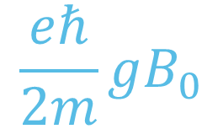

Spin qubits
$$\frac{eℏ}{2m}gB_{0}$$
$$B_{0}$$
Notes:
There is a more clever way to use the hydrogen atom system as a qubit. By loading it with a single electron, and applying an external magnetic field, we can use the Zeeman split spin-states of the electron as the two-level system for the qubit. The amplitude of the field tunes the qubit frequency, and it can be easily set to the microwave regime, where coherent control is easier to achieve.

Slide 10
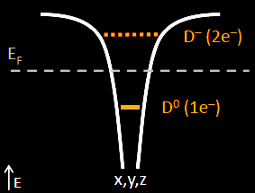
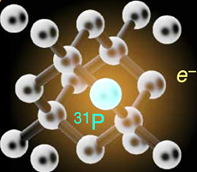
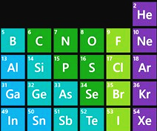
Spin qubits: donor atoms
P vs Si: one more proton
Coulomb binding potential
Loosely bound 15th electron of P
Bohr radius ~ 2 nm

Slide 11
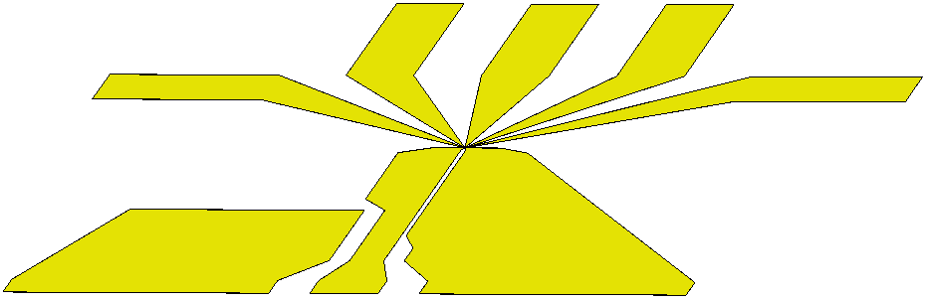
Spin qubits: donor atoms
Ion-implanted 31P donors
Si

Slide 12
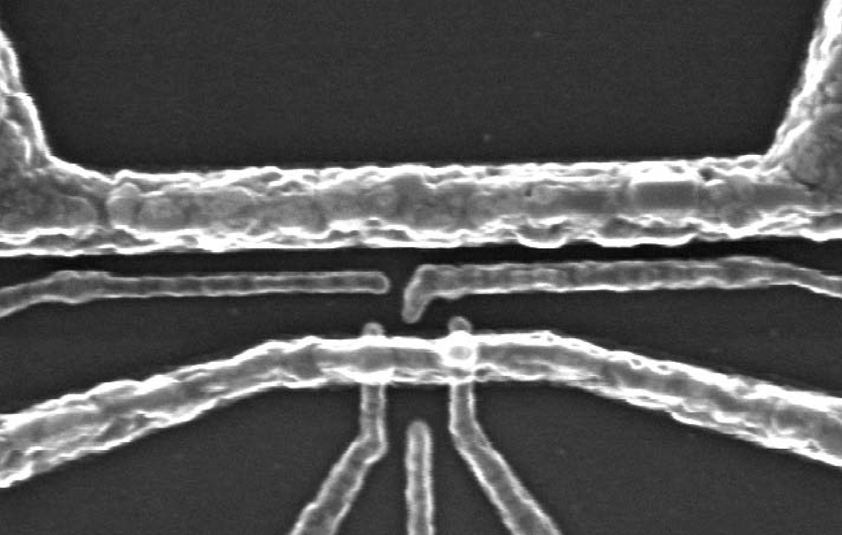
Spin qubits: donor atoms → control
B₀
B₁
i_{ESR}
D
S
Operated at T ≈ 100 mK (≈ 2 GHz), B₀ ≈ 1.5 T, f ≈ 42 GHz

Slide 13


Spin qubits: donor atoms
RF Generator +
Phase control
How do we control the Hamiltonian?
$$Δ=ω_{0}−ω_{RF}=gμ_{B}B_{0}−ω_{RF}$$
B₀
S
D

Slide 14
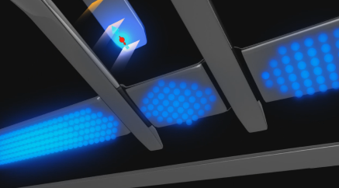
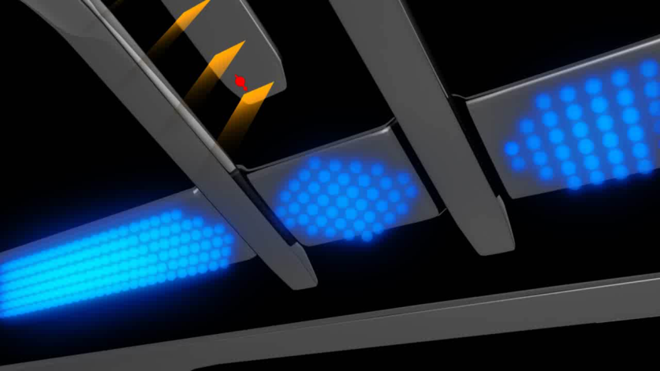
Spin qubits: donor atoms → measurement
1
0
I_{SET} (nA)
0
500
1
0
0
500
Time (μs)
+ electrical spin-down initialization
A. Morello et al., Nature 467, 687 (2010)

Slide 15

Spin qubits: donor atoms → 2-qubit operations
WF overlap → Exchange interaction $J S_{1}∙S_{2}$
If $ω_{1}−ω_{2}≪J$ → SWAP
If $ω_{1}−ω_{2}≫J$ → CZ → CNOT = H1 CZ H1
Q1
Q2

Slide 16
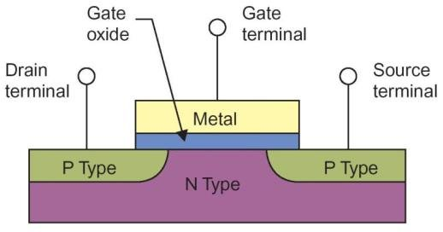
Spin qubits: quantum dots

Slide 17
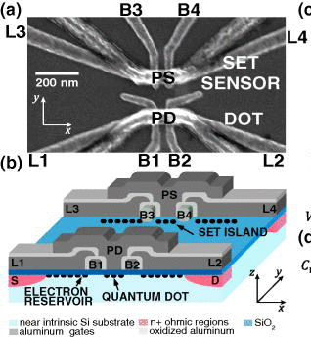
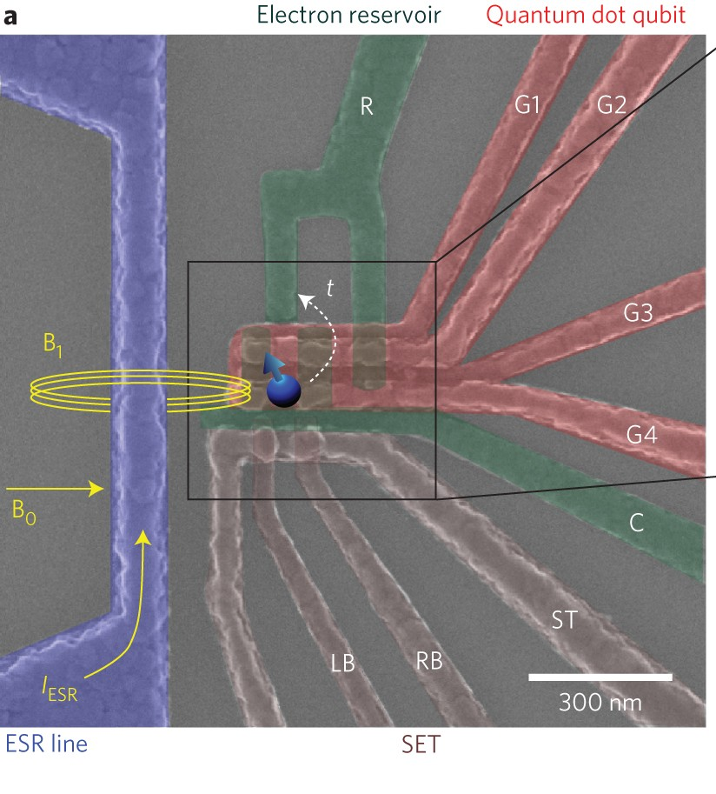
Spin qubits: quantum dots
C.H. Yang, et al., AIP Adv (2011)
M. Veldhorst, et al., Nature Nano (2014)

Slide 18
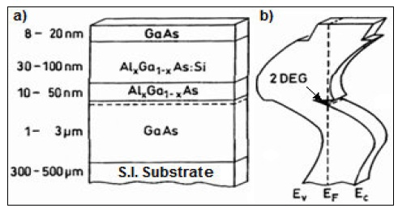
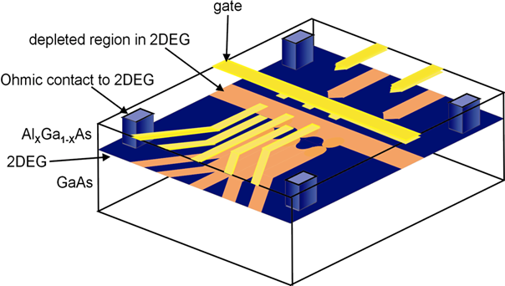
Spin qubits: quantum dots

Slide 19
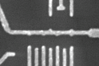
Spin qubits: quantum dots

Slide 20
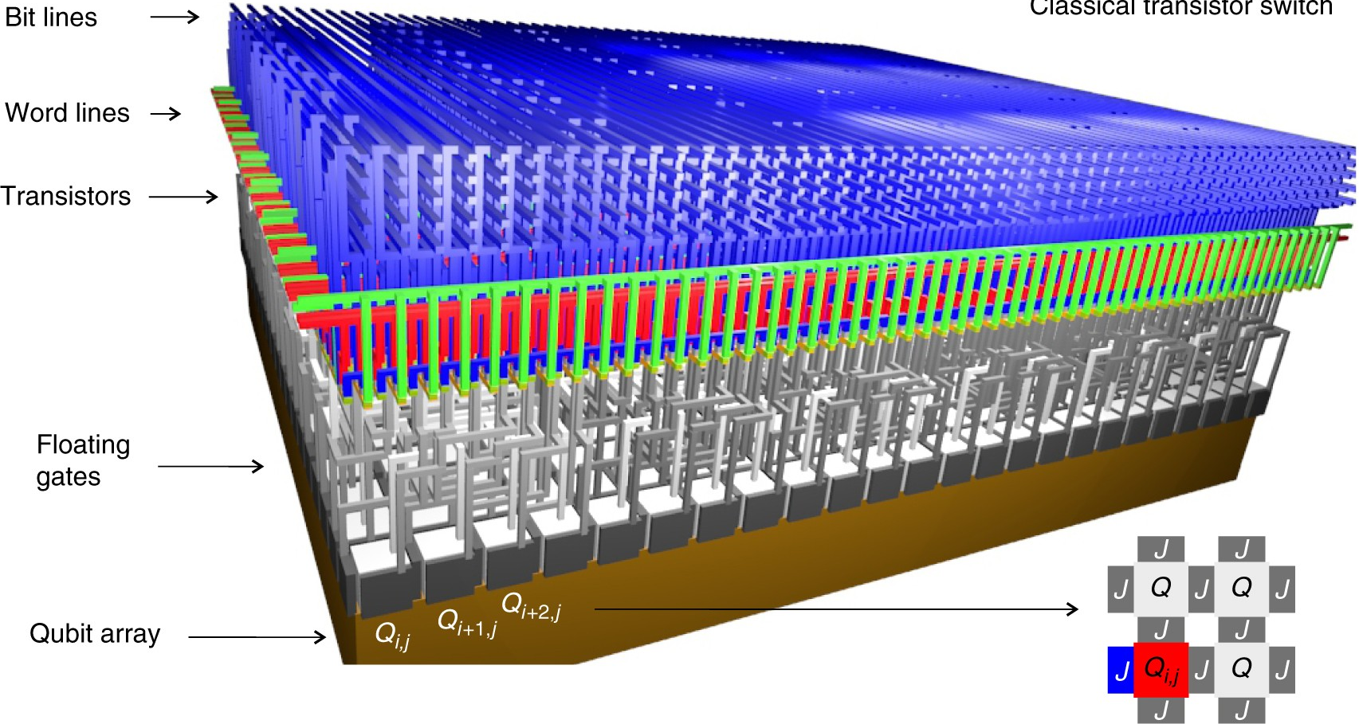
Spin qubits: quantum dots
M. Veldhorst, et al., Nature Comms (2017)

Slide 21
NV centers in diamond

Slide 22

NV centers in diamond
$$𝓗=ΔS_{z}^{2}+gμ_{B}B_{0}S_{z}$$
$Δ$ → Zero-field splitting (2.88 GHz)

Slide 23
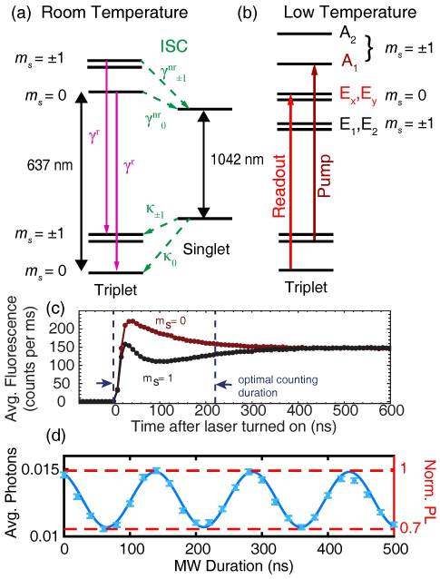
NV centers in diamond → measurements
D.A. Hopper, et al., Micromachines (2018)

Slide 24
NV centers in diamond → more qubits

Slide 25
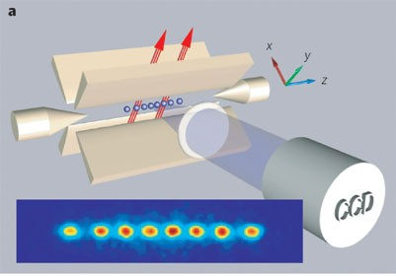
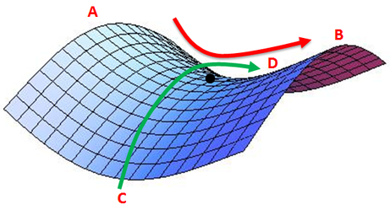
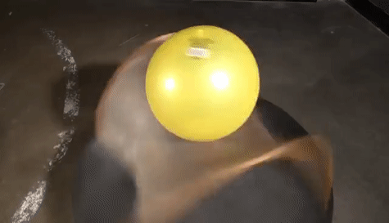
Trapped ion qubits
R. Blatt, et al., Nature (2008)

Slide 26
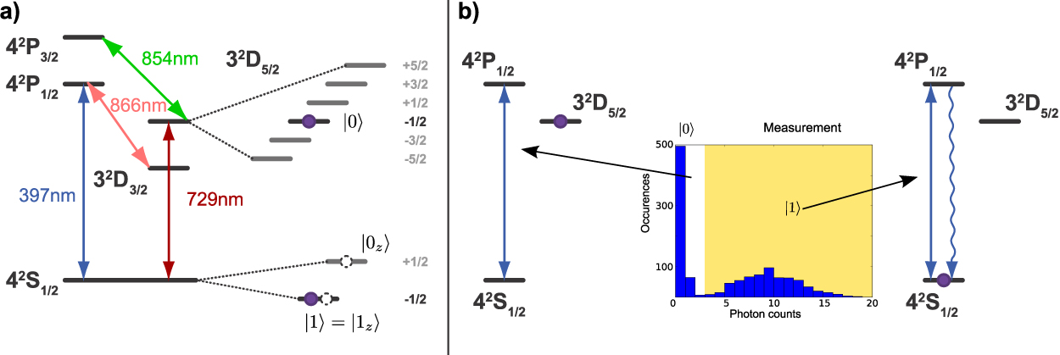
Trapped ion qubits
P. Schidler, et al., New J Phys (2013)

Slide 27
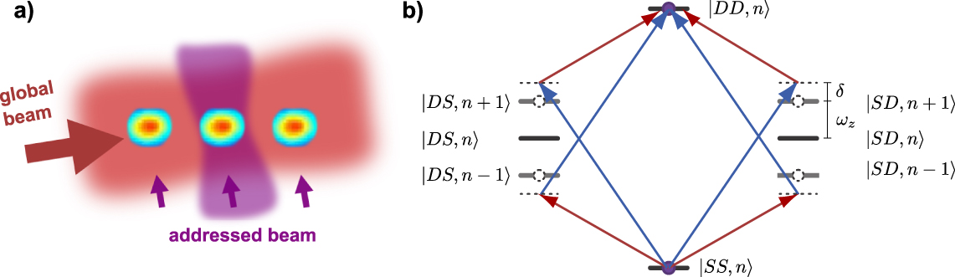
Trapped ion qubits
P. Schidler, et al., New J Phys (2013)

Slide 28
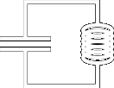




Superconducting qubits
$$C$$
$$L$$
$$H=\frac{{\hat{p}}^{2}}{2m}+\frac{mω^{2}{\hat{x}}^{2}}{2}$$
$$H=\frac{C{\dot{Φ}}^{2}}{2}+\frac{Φ^{2}}{2L}$$
Notes:
A harmonic oscillator can be realized electrically using a resonator circuit. The equivalent position variable is the magnetic flux through the loop of the inductor.

Slide 29
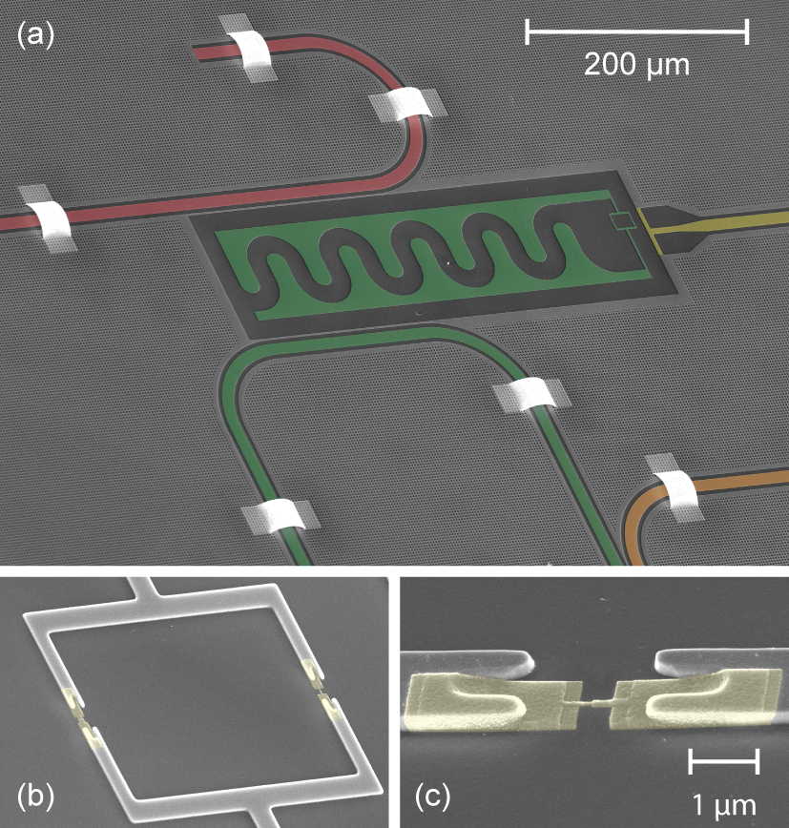
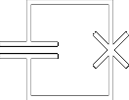
Superconducting qubits
Josephson junctions

Slide 30


Superconducting qubits
$$V=\frac{Φ^{2}}{2L}$$
$$V=−E_{J}\cos\left(\frac{2πΦ}{Φ_{0}}\right)$$
Notes:
We know that the harmonic oscillator cannot be readily used as a qubit, but we can substitute the inductor for an element that provides a sinusoidal potential, instead of a parabolic one. This creates an anharmonicity between the energy levels, and we can now uniquely address the bottom two energy levels of the system.

Slide 31
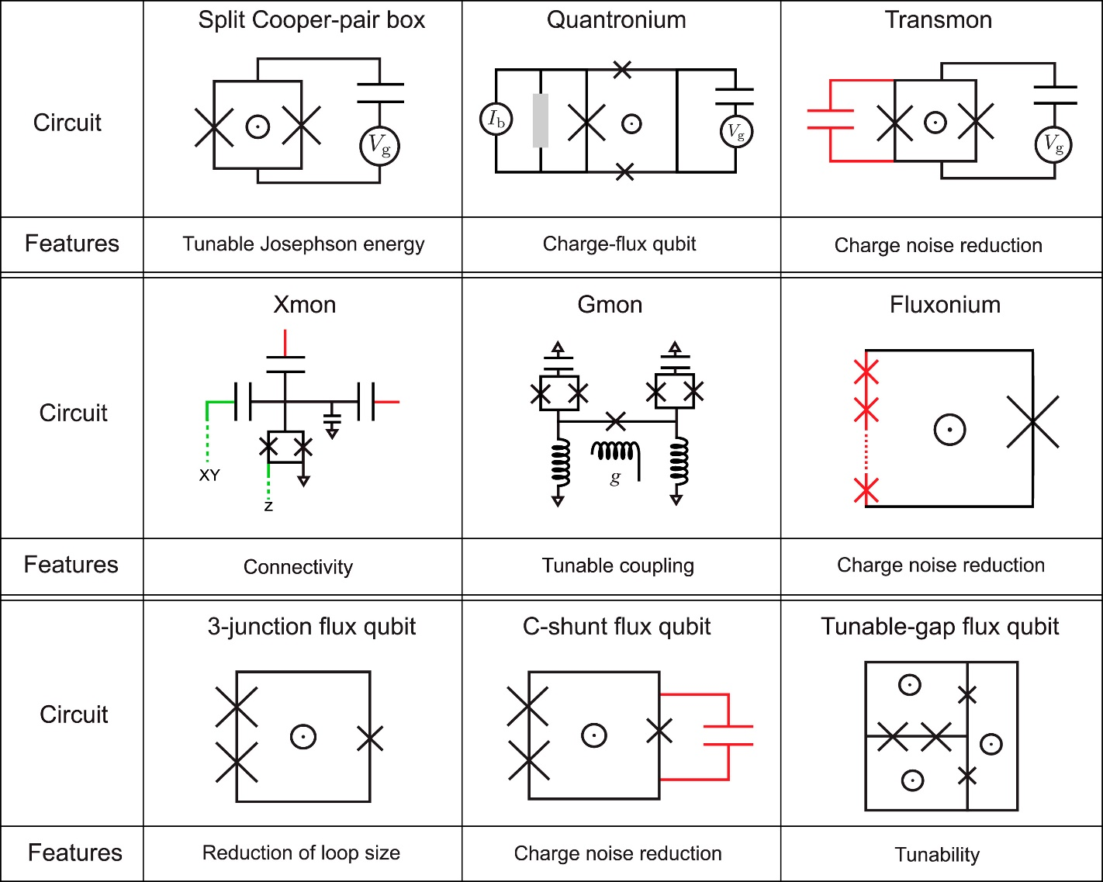
Superconducting qubits → many types

Slide 32

Superconducting qubits
Transmons:
$E_{J}≫E_{C}$ → charge insensitive

Slide 33


Superconducting qubits
$σ_{x,y}$ control
$σ_{z}$ control

Slide 34
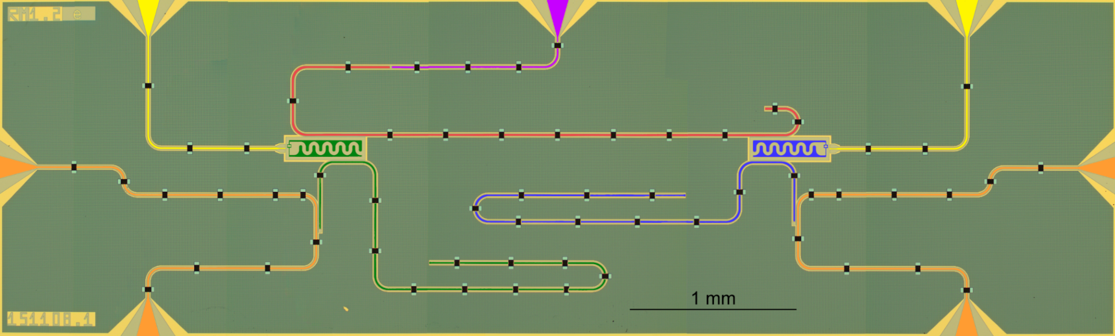
Superconducting qubits
Haroche group (200s)
Wallraff et al., Nature (2004)
Circuit quantum electrodynamics: light-matter interactions on a chip

Slide 35
Superconducting qubits
Resonator used for 1 and 2 qubit gates
Resonators used for measurements

Slide 36
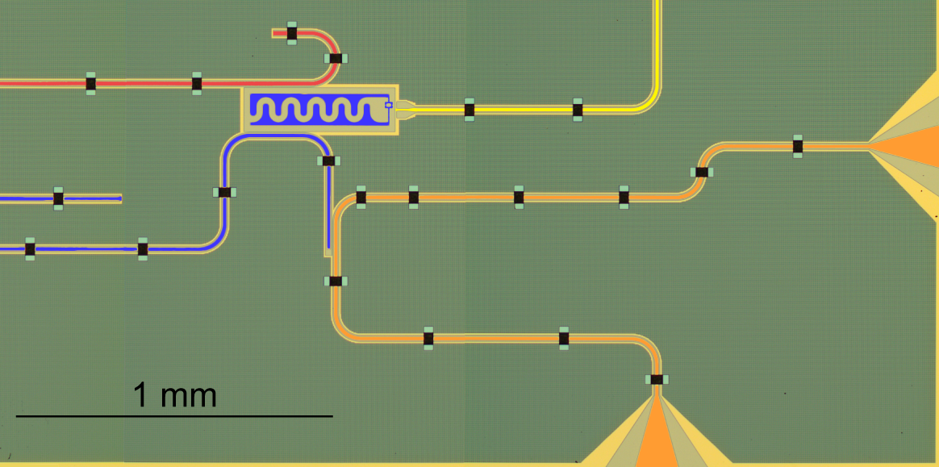


Superconducting qubits
Rabi interaction: field-dipole coupling
g
Jaynes-Cummings interaction: strong coupling regime
Jaynes-Cummings interaction: dispersive regime
Component frequencies
Rabi, Phys Rev 49, 324 (1936)
Jaynes & Cummings, Proc IEEE 51, 89 (1963)

Slide 37
Superconducting qubits → measurements
g
Jaynes-Cummings interaction: dispersive regime

Slide 38
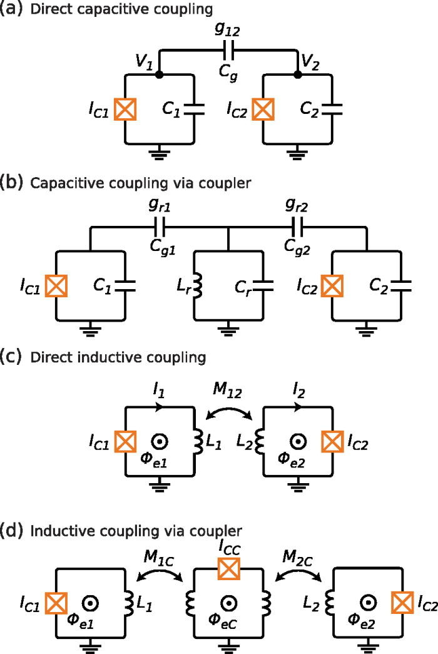

Superconducting qubits → 2-qubit operations
$$ℋ_{coup}=gσ_{x,1}σ_{x,2}$$

Slide 39
Superconducting qubits → 2-qubit operations

Slide 40


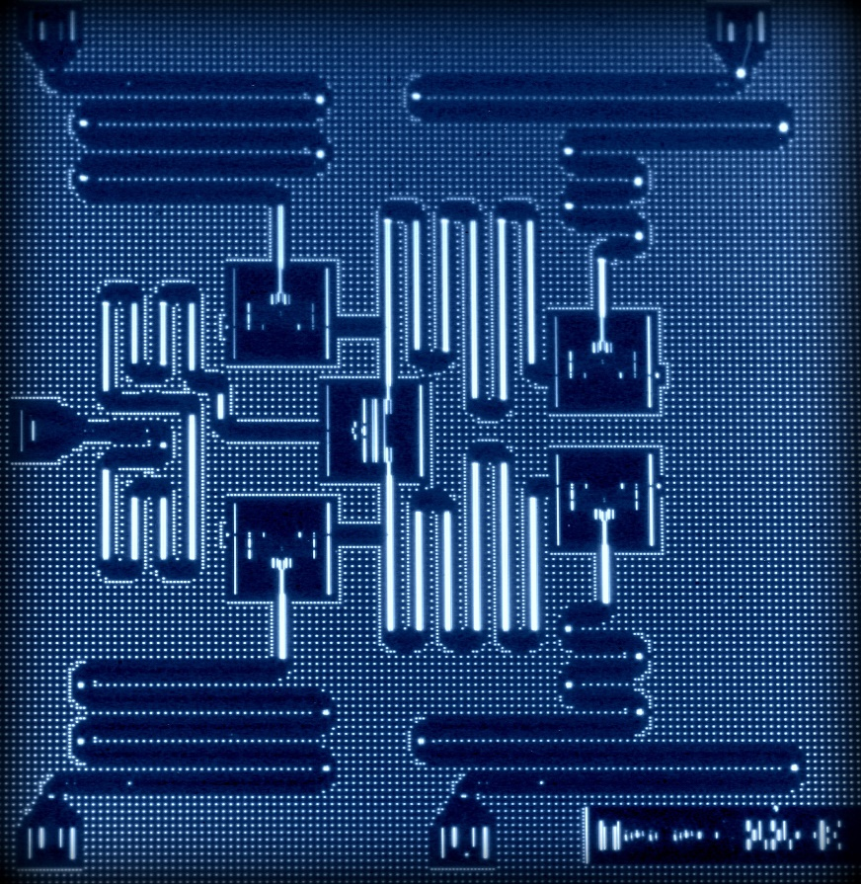
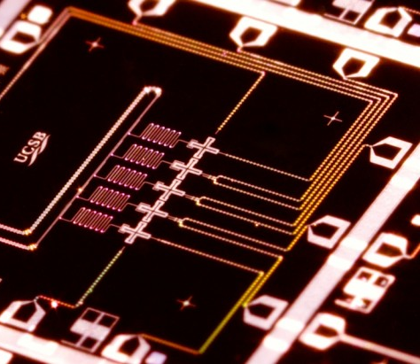
Superconducting qubits

Slide 41
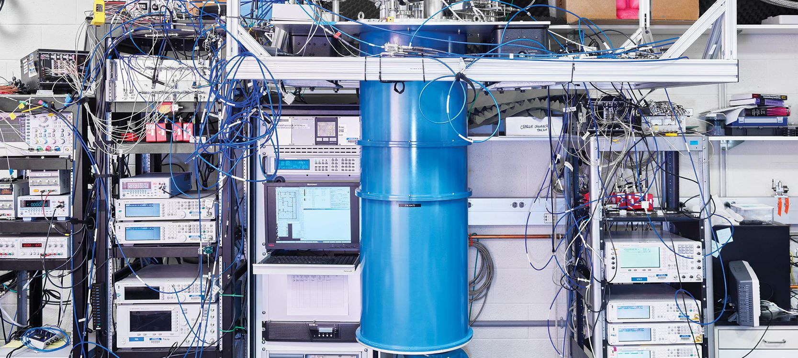
Inside a quantum computing lab

Slide 42
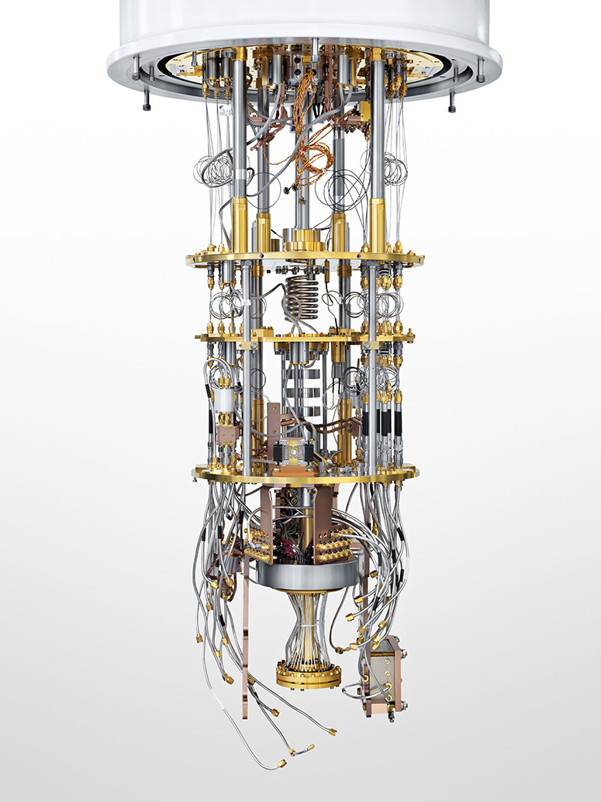
Cold qubits
Qubit systems are extremely sensitive to their environment
The most effective way to ‘quiet down’ the environment is to ‘freeze’ it → 0 K (-273 C)
How low can we go?
  Liquid Nitrogen → 77 K (-196 C)
  Liquid Helium → 4 K (-269 C)
  Dilution fridge → 10 mK (272.99 C)
YouTube: Quantum Cooling to (Near) Absolute Zero

Slide 43
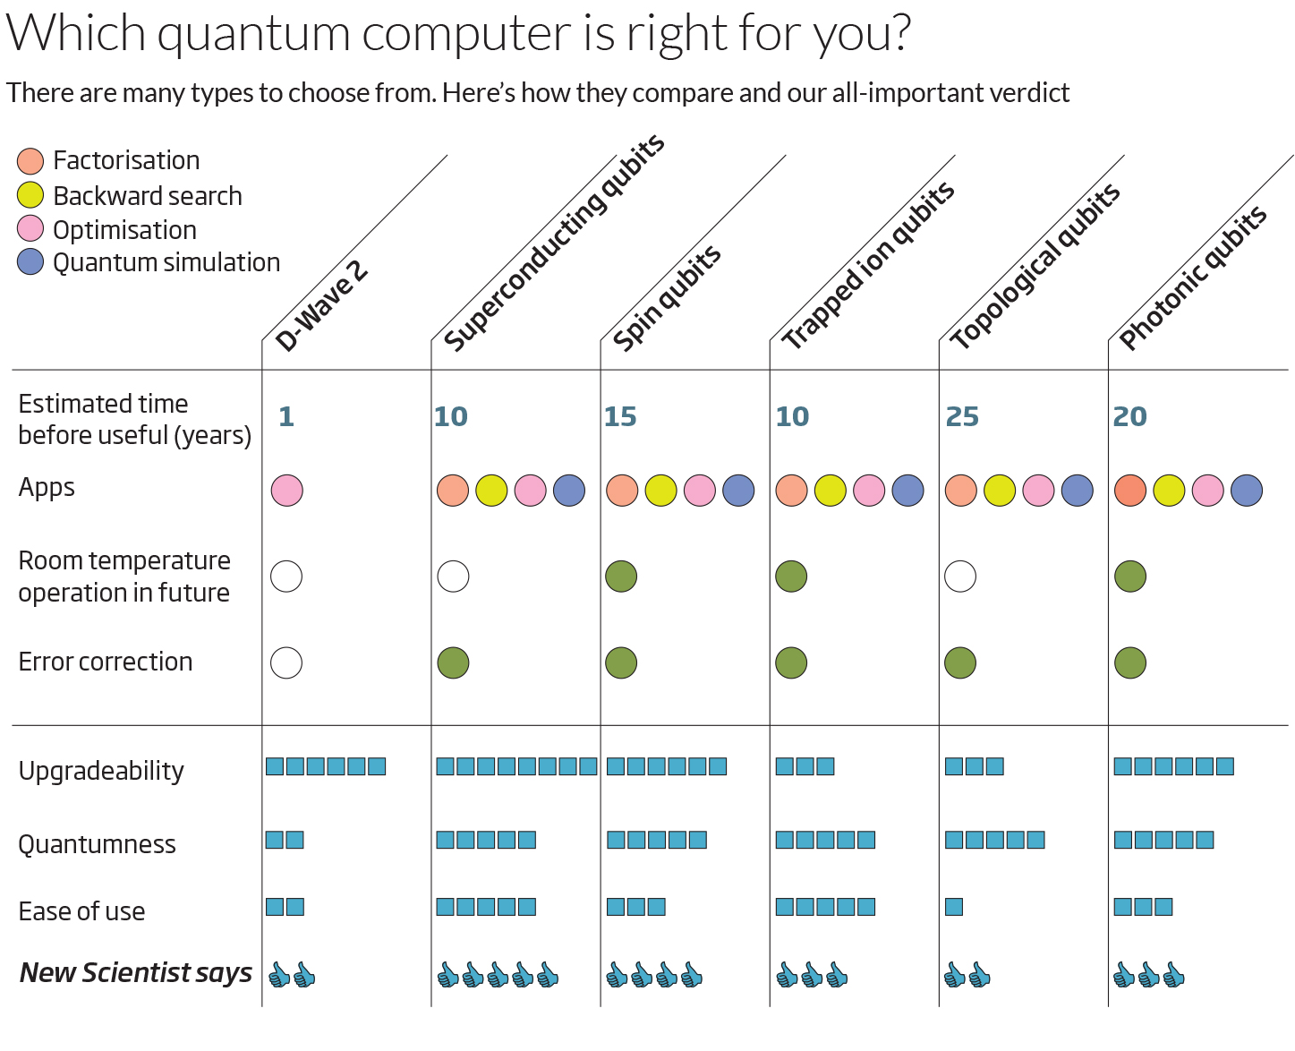
Quantum computer buyer’s guide
New Scientist (2014)

